Slide 1
FAQ: Why doesn’t the sun look like it is setting in the center of the channel on the day that the PYC celebrates Sunset Down the Channel?
Answer: It’s all a matter of your perspective.
David Roseman
August 8, 2012

Slide 2
The sun is so far away that, for all practical purposes, its rays are parallel
The bearing of the channel is about 293.3 degrees true
The Sunset Down the Channel date is selected as the date when the sun sets at about 293.3

Slide 3
Assume three people observing the sunset on August 6, 2012. One is standing on the east end of the north pier, the second is standing on the east end of the south pier, and the third is standing at the SW corner of the PYC property.

Slide 4
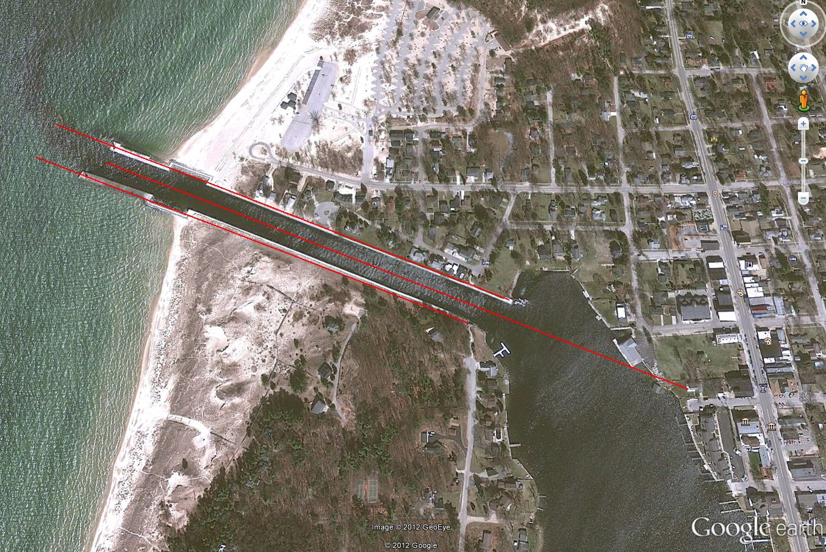
With some help from Google Earth…
1. Look!! The sun is setting at the North pierhead!
2. No!! The sun is setting at the South pierhead!
3. Actually, the sun is setting down the center of the channel

Slide 5
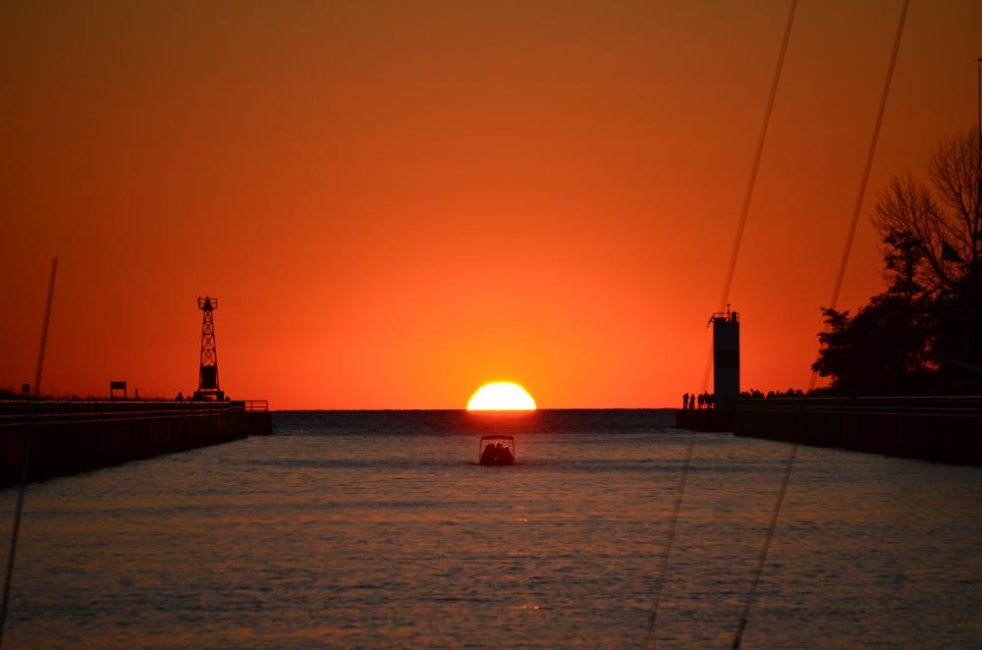
The centerline view
August 6, 2012
The 15' Boston Whaler Summer Visit cruises inbound. Aboard are Kim, Jennifer, Katelyn and Lacey Jacobs, and (Granddad)David Roseman.
Photo by Rilla and Joe Nameth, setup by David Roseman.

Slide 6
So…
Almost all of the PYC property is north of the centerline. If you are sitting in a blue chair on the PYC deck, or anywhere else on PYC property north of the centerline, the sun will appear to be setting north of the channel.
Perhaps we should calculate the angles for each deck chair, and celebrate for many days.

Slide 7
For more information, visit
http://Patterson-marine.com/sunset/sunset_calculations_2020.htm

